Slide 1
Session 2 part 2

Slide 2
Relationships

Slide 3
What Are Database Relationships?
database relationships define how data in one table connects to data in another.
A relationship in a DBMS exists when a variable has a connection with the properties stored in different tables.
They're exhibited usually via keys in a table, which is either columns or fields that specify a distinctive arrangement for each record.
Notes:
Database relationships form the backbone of relational databases, enabling data to connect logically across multiple tables. They ensure your data remains structured, accessible, and meaningful, providing the foundation for powerful analytics and seamless operations. Understanding these relationships is key to building scalable and efficient systems, whether you are working with customer orders, employee hierarchies, or inventory tracking.

Slide 4
One-to-one (1:1) relationships

Slide 5
One-to-one
A one-to-one relationship connects one record in a table to exactly one record in another table
Use Case: In a healthcare database, a "Patients" table may have a one-to-one relationship with a "Medical Records" table. Each patient is linked to a unique medical record, ensuring sensitive health information is stored separately.
Notes:
Student ↔ Locker: At many schools, a specific student is assigned to exactly one locker, and each locker belongs to only one student.
Resident ↔ Mailbox: In some housing complexes, each resident has exactly one assigned mailbox

Slide 6
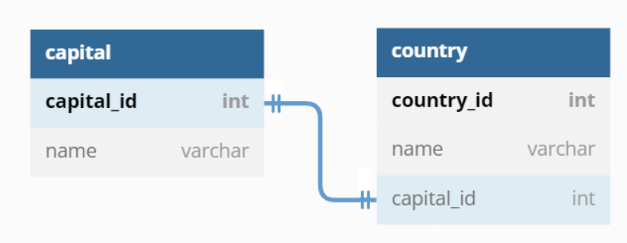
Notes:
Two tables with information about countries and capital cities connect in a database using a primary key. For example, when added to the country table, the unique ID of a capital city (its primary key) becomes a foreign key, creating a relationship.
In a one-to-one (1:1) relationship, you typically place the foreign key (FK) in the dependent (child) table. While the data could technically be linked from either side, the placement usually follows the logic of which record depends on the other for its existence

Slide 7
One-to-many (1:N) relationships

Slide 8
One-to-many
In a one-to-many relationship, a single record in one table can be associated with multiple records in another table. This is one of the most common relationship types in relational databases.
Use case: An "Authors" table might connect to a "Books" table, where each author can have multiple books attributed to them.

Slide 9
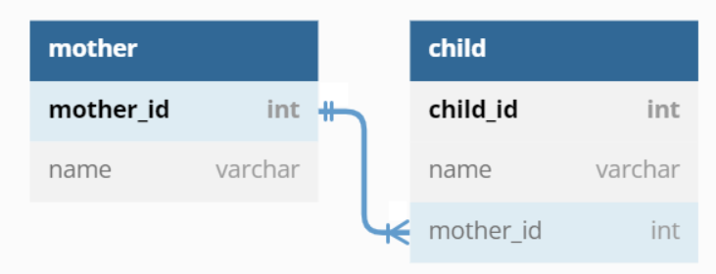
Notes:
A database containing two tables with information about mothers and children connects using a primary key. When added to the child table, the unique ID from a mother becomes a foreign key. Different children can have the same mother.
The Foreign Key always goes on the "Many" side. * Analogy: A child carries their parent's last name (ID) to show where they belong. You don't tattoo every child's name on the parent!

Slide 10
Many-to-many (N: N) relationships

Slide 11
Many-to-many
A many-to-many relationship occurs when multiple records in one table are related to multiple records in another table. This is implemented using a junction table to manage the connections.
Use case: In an education system, students can enroll in multiple courses, and each course can have multiple students. A "Student-Course" junction table is used to connect the "Students" and "Courses" tables.

Slide 12
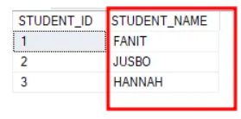
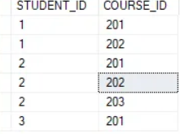


Slide 13
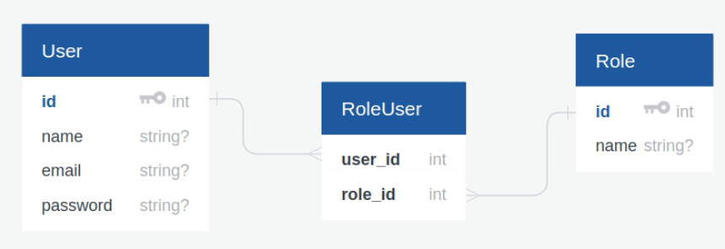

Slide 14
NORMALIZATION
the process of structuring a relational database to reduce data redundancy and improve data integrity
Notes:
Database normalisation is the process of organizing the attributes of the database to reduce or eliminate data redundancy (having the same data but at different places).
Data redundancy unnecessarily increases the size of the database as the same data is repeated in many places. Inconsistency problems also arise during insert, delete, and update operations.
In the relational model, there exist standard methods to quantify how efficient a database is. These methods are called normal forms, and there are algorithms to convert a given database into normal forms.
Normalization generally involves splitting a table into multiple ones, which must be linked each time a query is made requiring data from the split tables.
https://www.digitalocean.com/community/tutorials/database-normalization

Slide 15
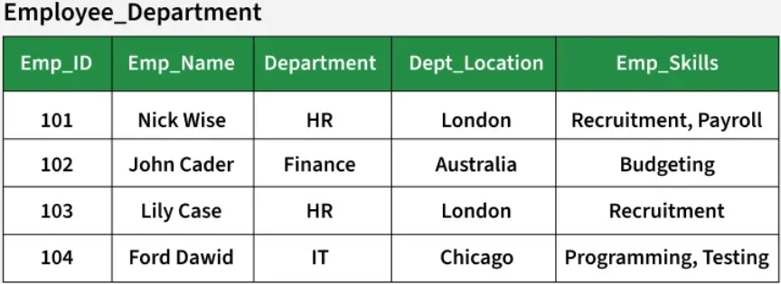
Notes:
Problems in the Employee_Department Relation
Insertion Anomaly: If a new department is created but no employee is assigned to it yet, we cannot store its location because we need an employee record to insert.
Update Anomaly: If the location of the HR department changes, we must update it in multiple rows (for both Nick Wise and Lily Case). If one row is missed, the data becomes inconsistent.
Deletion Anomaly: If all employees in the IT department leave, we lose the department information, including its location.
Data Redundancy: The department location is repeated for every employee in the same department.
Insertion Anomalies: Insertion anomalies occur when it is not possible to insert data into a database because the required fields are missing or because the data is incomplete. For example, if a database requires that every record has a primary key, but no value is provided for a particular record, it cannot be inserted into the database.
Deletion anomalies: Deletion anomalies occur when deleting a record from a database and can result in the unintentional loss of data. For example, if a database contains information about customers and orders, deleting a customer record may also delete all the orders associated with that customer.
Updation anomalies: Updation anomalies occur when modifying data in a database and can result in inconsistencies or errors. For example, if a database contains information about employees and their salaries, updating an employee’s salary in one record but not in all related records could lead to incorrect calculations and reporting.

Slide 16
The First Normal Form – 1NF
For a table to be in the first normal form, it must meet the following criteria:
a single cell must not hold more than one value (atomicity)
there must be a primary key for identification
no duplicated rows or columns
each column must have only one value for each row in the table

Slide 17
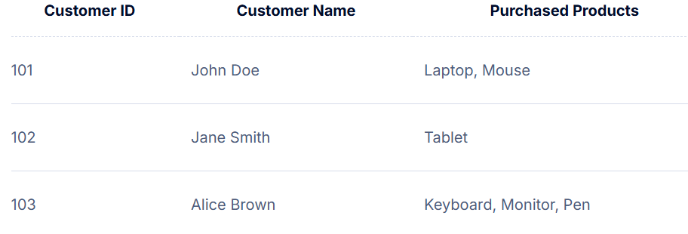
Notes:
Why is this not in 1NF?
Non-atomic values: “Purchased Products” contains multiple items per cell.
Querying and updating are complex: Searching for customers who bought “Mouse” requires string parsing.
Data integrity risks: No way to enforce referential integrity between products and customers.
Inconsistent data entry: Different delimiters or typos can creep in.
Reporting challenges: Generating reports such as “How many customers bought a Laptop?” becomes complicated, as you cannot simply filter a column for “Laptop”, you must parse the string.
Update anomalies: If a product name changes (e.g., “Mouse” to “Wireless Mouse”), you must update every occurrence in every cell, increasing the risk of missing some entries.
Data integrity risks: There is no way to enforce referential integrity between products and customers, which can lead to orphaned or inconsistent data.

Slide 18
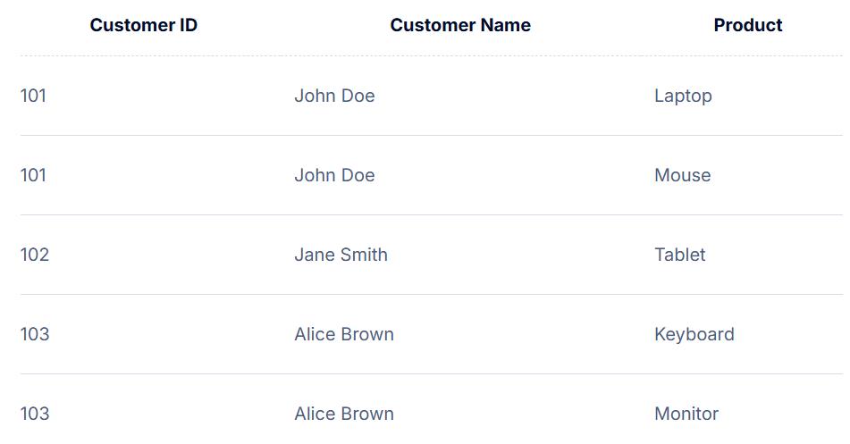
Notes:
Transformation Steps to Achieve 1NF:
Identify columns with non-atomic values: In this case, “Purchased Products” contains multiple values.
Split the multi-valued column into separate rows: Each product purchased by a customer should be represented as a separate row, ensuring that every field contains only a single value.

Slide 19
The Second Normal Form – 2NF
A table is said to be in 2NF if it meets the following criteria:
it’s already in 1NF
has no partial dependency. That is, all non-key attributes are fully dependent on a primary key.
Notes:
partial dependencies, where a non-key attribute depends only on part of a composite key.

Slide 20
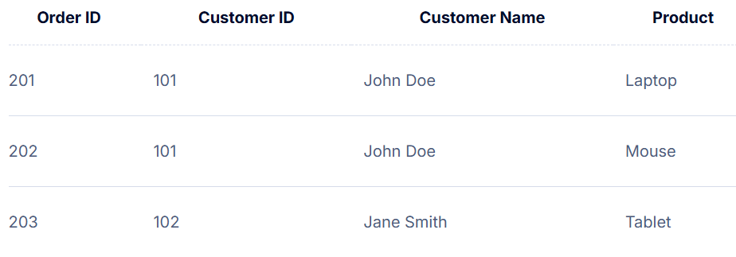
Notes:
“Customer Name” depends only on “Customer ID”, not the full primary key (“Order ID”, “Customer ID”). This is a partial dependency.

Slide 21
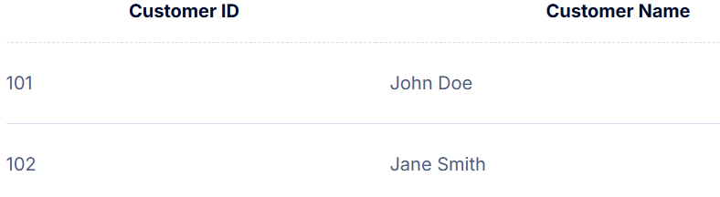
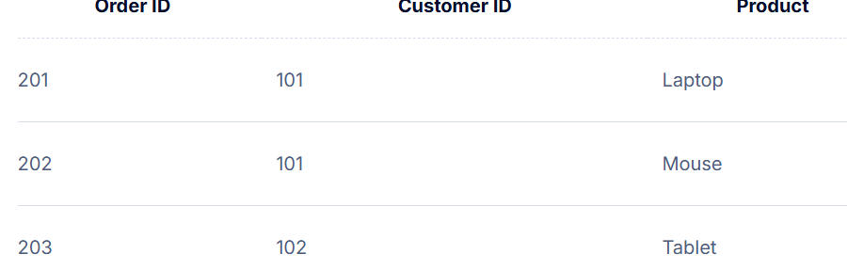
Notes:
Normalization to 2NF:
Separate customer information into its own table.
Benefits:
Eliminates redundancy of customer details.
Simplifies data maintenance and updates.

Slide 22
The Third Normal Form – 3NF
So, for a table to be in 3NF, it must:
be in 2NF
have no transitive partial dependency.
Notes:
This means a non-prime attribute (an attribute that is not part of the candidate’s key) is dependent on another non-prime attribute. This is what the third normal form (3NF) eliminates.

Slide 23
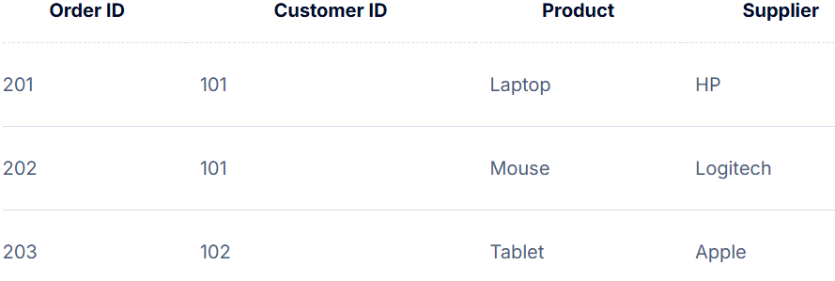

Slide 24
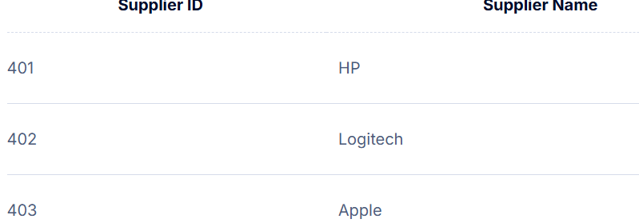
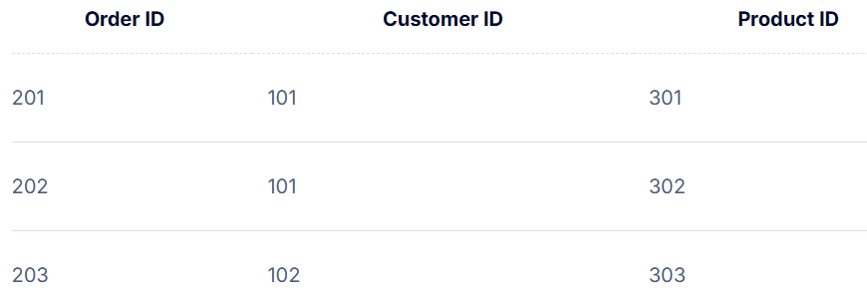
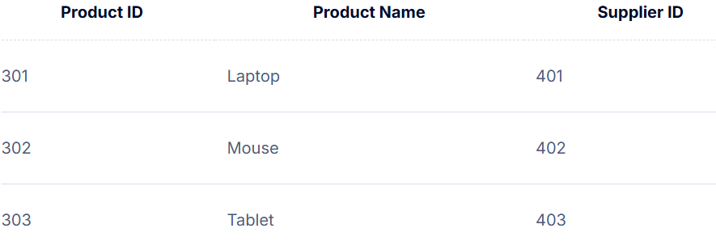
Notes:
Benefits:
Removes transitive dependencies.
Reduces data duplication.
Improves data integrity and maintainability.

